Slide 1
Blindness Detection
CS 584 – Machine Learning
Girish Rajani-Bathija (A20503736)
Shriya Prasanna (A20521733)
Bhavesh Rajesh Talreja (A20516822)

Slide 2
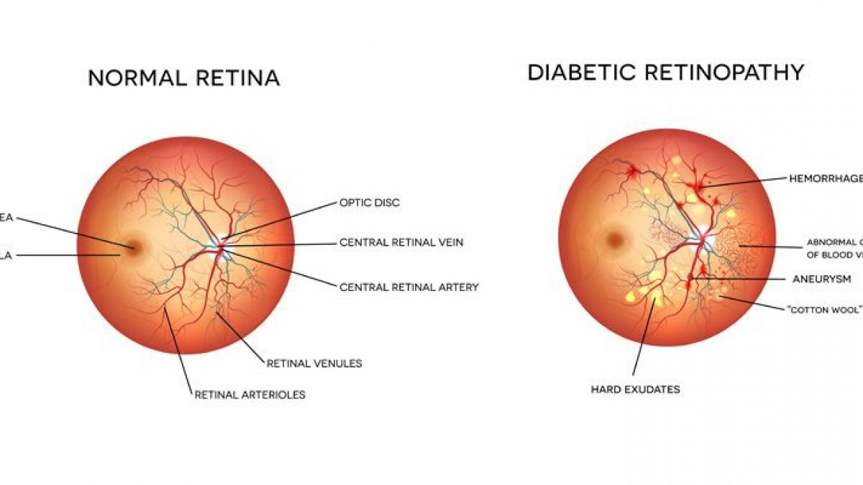
Problem Statement
Diabetic retinopathy is one of the most common causes of blindness in people who have diabetes
It is important to take a screening exam for early detection
Lack of infrastructure and skilled professionals in some rural areas
Very time-consuming and labor-intensive

Slide 3
Proposed Solution & Dataset
Implement various Deep Learning models to perform multi-class image classification.
Dataset: APTOS 2019 Blindness Detection dataset
Contains 3,662 training (later split into 2,462 training samples, and 1,200 validation samples) and 1,928 testing retina images. Each image is labelled as belonging to 1 of 5 classes:
Custom CNN Model
VGG-16
ResNet
0 - No DR
1 - Mild
2 - Moderate
3 - Severe
4 - Proliferative DR

Slide 4
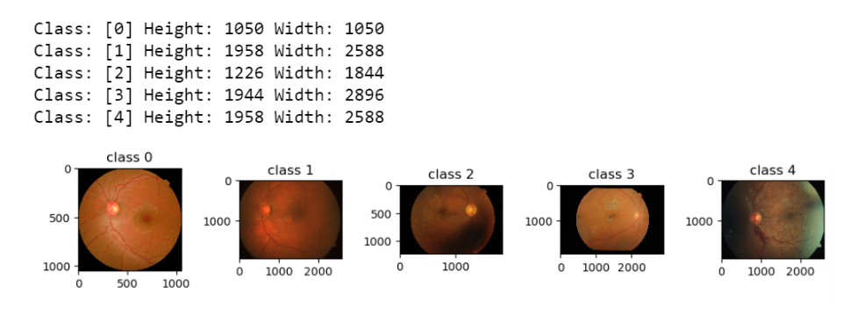
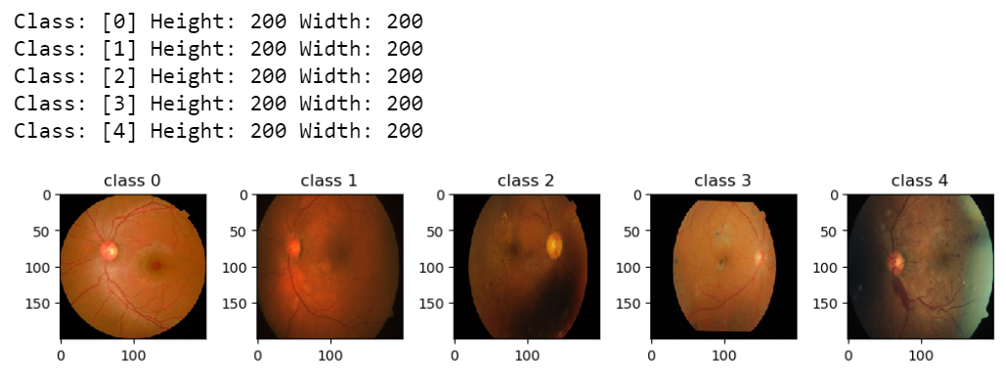
Data Exploration
Images within the dataset had different dimensions ranging from 474 x 358 pixels to 3388 x 2588 pixels. For uniformity, all images were resized to 200 x 200 pixels.

Slide 5
Dataset Class Imbalance
The distribution of samples among the five classes varies significantly
Perform data augmentation (rotation - 90°, 180°, 270°) on classes 1, 3, and 4 to create more samples and achieve a more balanced dataset

Slide 6
Dataset Class Imbalance Cont’d

Slide 7
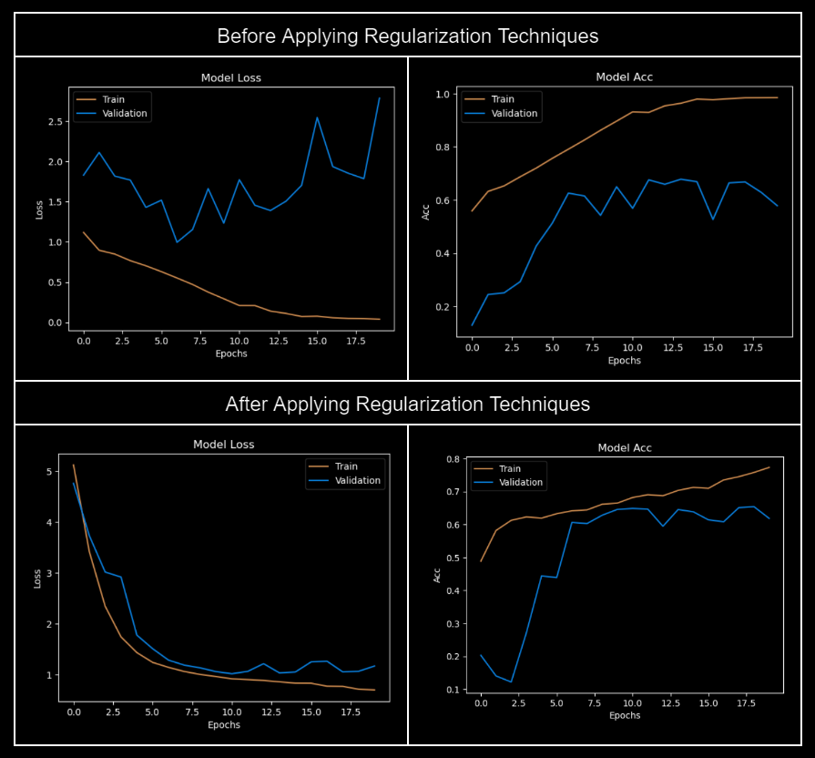
Custom CNN Model Results

Slide 8
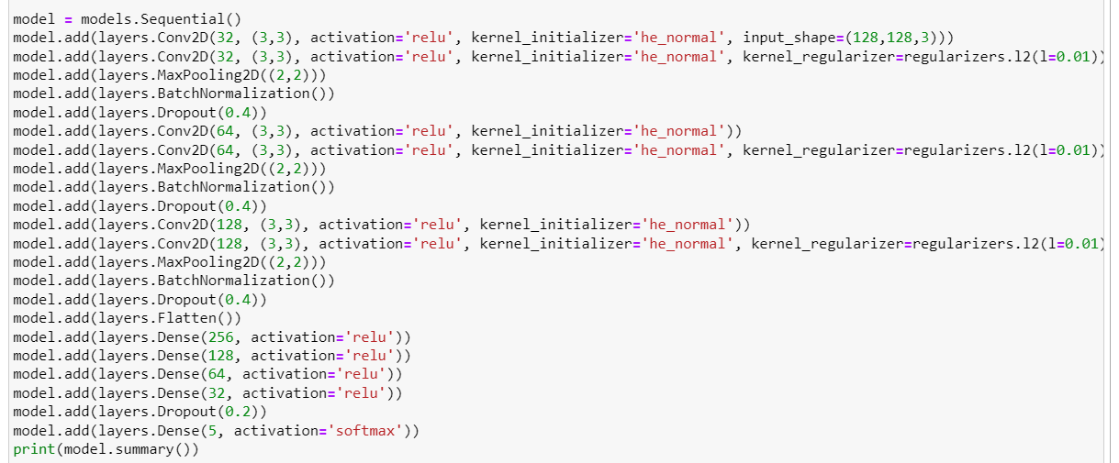
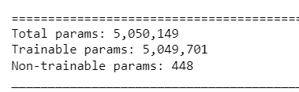
Custom CNN Architecture
Regularization Techniques:
L2 regularizer
weight he initialization
dropout layers

